Slide 1
The Cost of Job Security Regulation: Evidence from Latin American Labor Markets
James J. Heckman
Carmen Pagés

Slide 2

Latin America

Slide 3
Latin America labor codes
Indefinite contracts have severance pay obligations
Temporary contracts can be terminated at no cost when time has elapsed

Slide 4
Job Security Legislation
Designed with the intent to reduce a worker’s odds of losing their job
Hence such legislation contains various provisions that increase the cost of dismissing a worker
Objective of the paper is to construct measures of this across countries of LA and investigate effects on labor market outcomes

Slide 5
Costs of dismissing a worker
Advance notification / or compensation
Compensation for dismissal
Seniority premium
Foregone wages during trial of contested dismissal
Each of these is pinned down in subsequent slides

Slide 6
Advance notification
Law allows firms to choose to give advanced notice, or they can pay a compensation equivalent to wages over that period
Should be considered a dismissal cost because productivity falls when advance notice has been given

Slide 7
Compensation for dismissal
To be paid in event of unjustifiable dismissal
In Latin America, economic difficulties are not grounds for termination, therefore any reduction in labor force classifies as unjustified dismissal

Slide 8
Seniority premium
To be paid regardless of who initiates the separation
Firms allocate a portion of monthly wages into a fund that collects the seniority wage
Firm has to pay the premium, even if fund doesn’t cover it

Slide 9
Upcoming table
Measure of the cost dismissing a worker in unfavorable conditions
Includes- cost of advance notification and compensation for unjustifiable dismissal
Does not include seniority premium and foregone wages due to trial

Slide 10
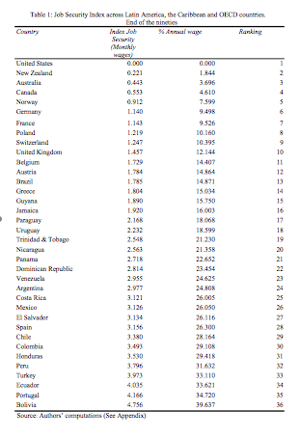

Slide 11
When a shock occurs firm can do one of the following
Dismiss workers
Hire workers
Do nothing

Slide 12
Negative shock
Firms dismisses workers
Firms that face JS legislation have to pay dismissal costs, this discourages them from dismissing workers
Therefore, the JS-faced firm will dismiss fewer workers

Slide 13
Positive shock
Firms hire more workers
Firms that face JS legislation have to take into account that they will have to pay dismissal costs when shock passes
Therefore, the JS-faced firms will hire fewer workers

Slide 14
Labor market effects of increases in JS
Lower employment rates in expansions
Higher employment rates in recessions
Lower turnover rates
  Positive effects in terms of incentives for training
  Effect on effort ?
  Harder to adjust to changing needs for skills

Slide 15
Conclusion
Higher JS rates reduce turnover rates
Composition of employment is biased against young workers and against employment in the formal sector

Slide 16
Empirical Studies
Impact of Job Security on turnover rates
  Changes in the duration of jobs (tenure)
  Duration of unemployment
  Exit rates out of unemployment and out of employment

Slide 17
Higher employment exit rates mean more layoffs or quits
Higher exit rates out of unemployment mean higher job creation

Slide 18
Evidence Kugler 2000
Labor market reforms of Colombia
Less stringent Job Security legislation is associated with higher turnover rates
Less stringent Job Security legislation is associated with lower duration of unemployment

Slide 19
Kugler 2000 (Different Study)
Reforms in Job Security legislation caused a decline in unemployment rates between 1.3 and 1.7 percent
Measured exit rates before and after reform in Colombia in 1991

Slide 20
Other studies confirm results
Lazear (1990) using OECD data
Grubb and Wells (1993)
Nickell (1997)
OECD (2000)

Slide 21
New empirical studies
Used OECD data and Latin America data
Ran cross-sectional OLS regressions
Found that Job Security legislation was statistically significant in causing lower employment

Slide 22
OLS results
Many more detailed results in their 2004 Edited volume on LAC
When regulations tighten, hours may go up, employment down
They also begin to investigate different components of reforms. E.g., Hopenhayn showed that Argentina’s 1995 reform in form of allowing all new contracts to have a 3 months trial period increased efficiency, labor turnover w/o reducing long tenure employment whereas new regimes for small firms and young workers had no effect

Slide 23
Conclusion
Job Security legislation are inefficient and inequality-increasing mechanism for providing income security
Job Security legislation protects worker from losing job, but also makes it harder for a person to find a job

Slide 24
Inequality-increasing
Reduces prospects on young, female, and unskilled workers

Slide 25
Proposed Policy
Policymakers should pursue broad coalitions of workers:
  Young
  Female
  Unemployed or discouraged
  As well as those employed

